Slide 1
MMORPG Server Structures
Server Game Programming

Slide 2
Contents
I. Overview of MMORPG Server Requirements
II. Types of Representative MMORPG Server Structures
III. Compartmentalization
IV. Scale-Up / Scale-Out
V. Multi-Process Server Structure

Slide 3

I. Overview of MMORPG Server Requirements

Slide 4
MMORPG Server Structure Overview: Requirements and Challenges
Key requirements of MMORPG Server
Handling large numbers of users: MMO stands for "Massive Multiplayer Online", which means a large number of concurrent users
High number of concurrent users (concurrent users) → Increased server load
Suddenly increased workload for servers
Responding to increased workload:
Servers must process many user requests in real time
Manage status, movement, interactions, etc. of each user → Increased server performance requirements
Nevertheless, stable service provision is necessary:
Providing uninterrupted service in a large user environment is essential
Need to secure continuity without server downtime or overload

Slide 5
Why Systematic Design of MMORPG Server Structure Is Necessary?
Efficient resource management:
Optimizing server resources to ensure stable operation for large-scale user processing
High availability and scalability:
A flexible scalable structure is required according to the number of users
∴ A specialized server structure is essential to handle the large number of users and high workload of MMORPGs.

Slide 6


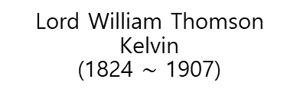
“If you cannot measure it, you cannot improve it.” - Lord Kelvin (William Thomson) –
How to measure workload?
If the workload is measurable, then we can distribute the workload!
What could be representative workload unit in MMORPG?
Lord William Thomson Kelvin
(1824 $∼$ 1907)

Slide 7

MMORPG Server Workload: Actor-level Work Processing
Workload Criteria: Actor Unit
Actor: All entities that move or interact within the game
Player Character ^{PC}: Performs various interactions such as movement and combat
NPC ^{Non-Playable Character}: Includes monsters, handles conversation, movement, combat, etc. based on AI
Etc.
Workload Increase Factor: The more actors there are, the more work the server has to manage

Slide 8
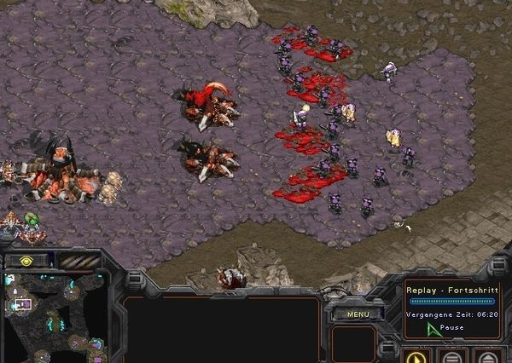
The concept of Control Zone
Control Zone: Manages special effects that occur in a specific area.
Example: Elements such as Poison Pool can be set as control zones.
Function:
Apply Effect: When a player or NPC enters the control zone, a specific effect (e.g. poison damage) is applied.
Poison Pools apply continuous damage to actors within the area.
Damage Over Time (DOT): This refers to damage that is continuously received over a certain period of time by a specific skill or effect.
Real-time detection: Control zones check actors entering the area and automatically apply effects.

Slide 9
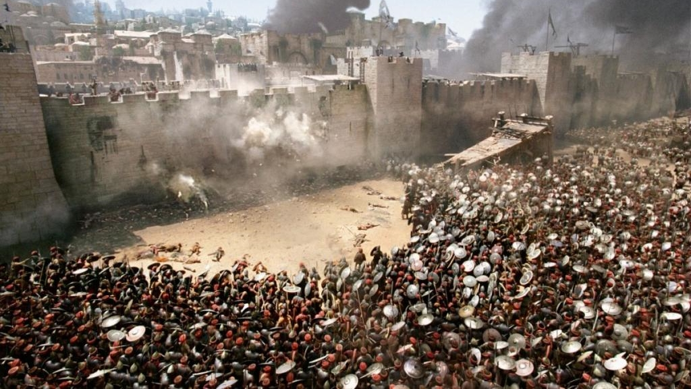
Actor example: Siege Warfare Terrain Features
Definition: A type of battle focused on capturing or defending specific areas like castles or fortresses.
Towers and Main Base: Defend a designated area and automatically attack enemies within that area.
Example: In the game League of Legends (LOL), towers automatically attack enemies that enter a certain range.
If the main base is attacked and destroyed, it impacts the game outcome.
Other Elements: In siege warfare, each tower or defensive mechanism is also an actor that the server needs to manage.
Handling Main Base Attacks and Destruction
Actors: The main base and towers can be considered actors.
Who is going to take care of all of this?

Slide 10
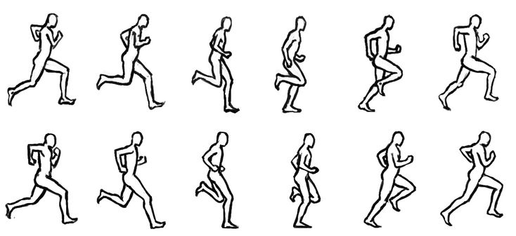
Factors that increase specific server workload
Processing real-time interaction tasks on a frame-by-frame basis:
The server continuously manages the status, movement, and interaction of all actors for each frame
C.f.> Web server, File server, DB server
Update the actions of each actor in real time to maintain game consistency and accuracy
Requires efficient resource management:
It is important to optimize the workload on an actor-by-actor basis to maximize server performance
∴ MMORPG servers must manage various elements such as actors and control zones in real time, and a systematic structure that efficiently processes this workload is essential!!!

Slide 11

Role of MMORPG Server?
Packet Processing (Read/Write)
Tick Processing:
Tick refers to a recurring interval of time in which the game server processes events.
Continuously updates the state of actors on every frame.
Heartbeat Functionality: Periodically checks and updates the location and status of users and NPCs.
Other Systems:
Auction House: An item trading system between users.
Siege Warfare: Supports large-scale battles in designated combat areas.
Additional Systems: Handles various in-game interactions and events.
Packet Processing + Tick Processing: Represents the majority (80%), with other tasks (20%).
Pareto Principle (80/20 Rule): An empirical rule stating that 80% of outcomes stem from 20% of causes.
∴ packet processing and tick processing are core components of an MMORPG server
Efficient management and optimization of these functions significantly impact server performance.

Slide 12
Volume of packet and tick processing…
Proportional to the number of actors
Actors↑, Ticks↑, Packets↑
As the number of players increases, the packet processing volume increases rapidly
Expected number of actors that the server must handle
Example: Let's say one server process receives 5,000 concurrent users!
10 ticks per second: per second (1000ms), one tick interval: 100ms
Meaning that all actor updates are continuously processed in 100ms...
100ms / 5,000 people = 0.02ms = 0.00002 seconds
If we consider NPCs...

Slide 13
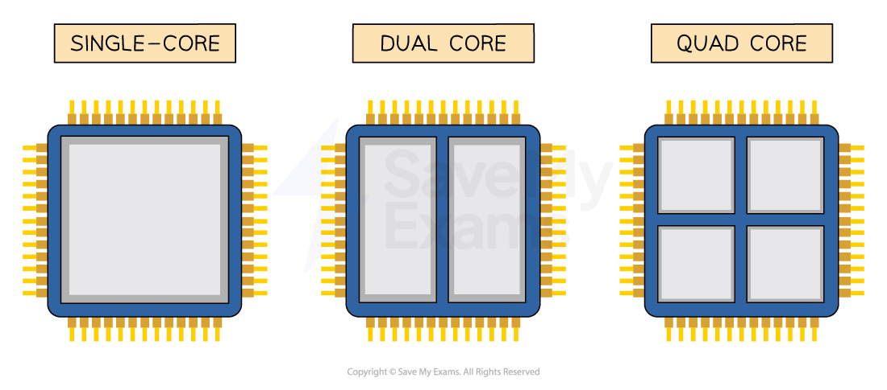
So… MMORPG Server need multithread programming?!?
Concurrent Execution per Core: Provides More Time to handle
Requires a well-designed server structure
But, programming in a multi-threaded environment is challenging
If not done properly, efficiency can be worse than single-threaded
100ms
100ms
100ms
100ms
100ms
100ms
100ms

Slide 14
To summarise by far …
The Server Has a Lot to Do!!!
Core Issue: The server's workload is heavy, and there is not enough time for a single CPU to handle it.
Solution: Distribute tasks in parallel using multi-threading and multi-processing.
Therefore: Multi-threaded programming is needed. However, if coded haphazardly, efficiency will not improve, and problems may arise.
So what should we do?!? Multi-process and multi-threaded design of MMORPG servers is essential for ensuring efficiency, and an optimized structure is key to successful server operation. But hard to do!

Slide 15
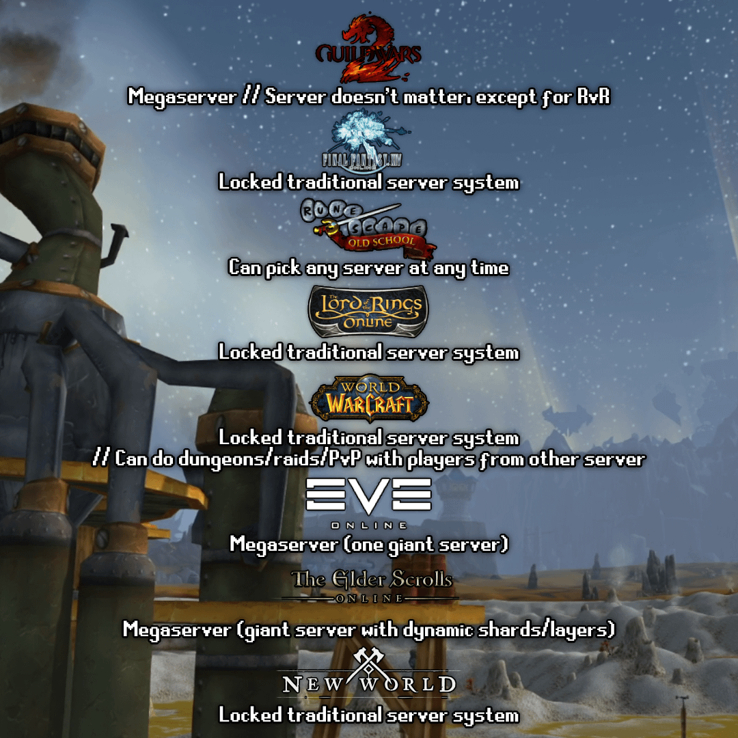
II. Types of typical MMORPG server structures

Slide 16
1. Classic single threaded structure
Network IO: Receives and forwards packets transmitted from clients
Receives packets from clients
Worker thread: Operates as a single thread, processes packets, and updates the tick of the actor
Takes packets one by one from the queue and processes them sequentially
Buffer (Queue): Buffer for forwarding packets received from network IO to the worker thread
Temporarily stores packets received from network IO
Worker thread empties the queue and processes packets every frame

Slide 17
1. Single Threaded Model
Network I/O
Queue
Work
Thread
.
.
.
.
.
.
.
.
.

Slide 18
Pros & cons
pros
Simple (easy to make)
cons
Difficult to secure time (cannot handle many actors)
It is actually used consistently due to its simple advantages!
Mass-produced MMORPG games are mostly single-threaded.
No need to consider issues that occur in multi-threading
Race condition, deadlock, thread safety, inconsistent state, livelock, priority inversion, context switching overhead, memory consistency issue, resource starvation, etc.
Easy to write and debug code, allowing for rapid development and release
Maximum 1,000-3,000 concurrent users Scalability limitations: not suitable for handling large number of users

Slide 19
2. Single thread + 𝛼 (dedicated thread)
Basic Structure:
Add dedicated threads for specific tasks to a single-thread structure.
Dedicated Thread: Threads dedicated to specific functions are added (e.g., DB I/O, auction house, siege battles).
DB I/O Thread: Handles database operations.
Auction House Thread: Processes requests related to the auction house.
Siege Battle Thread: Manages events related to siege battles.
Advantage: Reduces the load on the main work thread by separating key functions into dedicated threads.
Communication with Dedicated Threads:
The main work thread sends requests to dedicated threads.
Data and tasks are passed through asynchronous messages or locking.

Slide 20
2. Single thread + dedicated thread
Network I/O
Queue
Work
Thread
DB I/O Thread
Auction House Thread
.
.
.
.
.
.
.
.
.
Siege Battle Thread

Slide 21

Advantages and Limitations
Advantages:
Keep it simple: Distribute specific tasks while maintaining a simple single-threaded structure
Limitations:
Still limited number of concurrent users it can handle (approximately 5,000 or less)
Multi-threaded effect: Improve performance by separating key functions
May be limited for large-scale games that require high performance

Slide 22
3. Simple Multi Thread Structure
Similar to single-threaded architecture, but uses multiple worker threads to distribute work
Network IO: Receive packets from clients and store them in a queue
Multiple worker threads: Get packets from the queue and process them in parallel
∴ Each worker thread independently gets packets and actor lists, and processes tasks

Slide 23
3. Simple Multi Thread Structure
Network I/O
Queue
Work
Thread
Work
Thread
.
.
.
.
.
.
Work
Thread
Actor List

Slide 24
Major issues that occur in a multi-threaded environment without enough thought
Interaction issues between actors
MMORPG games are characterized by frequent interaction among actors
Ex: attack, defense, skill use, etc.
Ex: When A attacks B, if A and B are processed in different threads, locks are required
Need for mutual locking: When A attacks B, B can also attack A, increasing the risk of deadlock
Increased complexity: Due to frequent interactions between actors, the locking structure becomes more and more complex
Need for sophisticated deadlock management: If the lock order or priority is not adjusted, deadlocks can occur frequently
A simple multi-threaded structure may improve performance, but it can be more inefficient due to frequent locking and deadlock problems, and more sophisticated thread management and structural improvements are required!

Slide 25

Advantages and Limitations
pros:
Increased parallel processing efficiency: Multiple threads process tasks simultaneously to improve performance Simple implementation: Can be implemented by simply adding multiple worker threads without separate complex logic
cons:
Race conditions: Multiple threads can access the queue or actor list, which can cause race conditions.
Lock management required: Locking occurs due to data synchronization problems, which can degrade performance. (sometimes worse than a single thread model!)
Deadlock risk: Deadlock risk exists when incorrect locks are used.

Slide 26
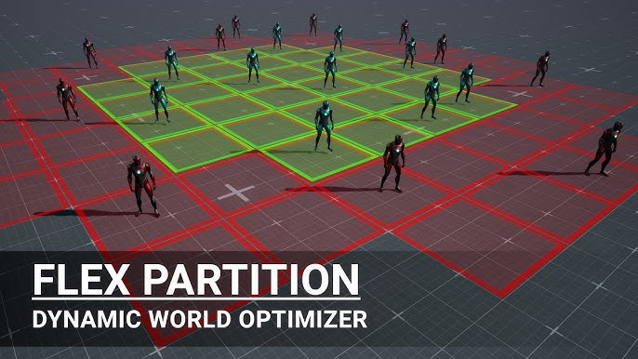
III. The Core of Multi-Threaded Architecture: Compartmentalization Strategy

Slide 27
Compartmentalization / Partitioning
What is compartmentalization?:
In multi-threading, actors and tasks are divided into compartments and each thread processes them separately.
Goal: Minimize locking and conflicts by separating each thread so that it can work independently.
Advantage: Reduces interaction between actors and reduces the risk of deadlock.

Slide 28
Compartmentalization strategy
Choosing a partitioning method:
Geographic partitioning: Assign actors to threads by partitioning them based on a specific area or region
Functional partitioning: Separate actors or tasks based on their functions such as movement, combat, and interaction
Factors for successful partitioning:
Performance is improved when each partition is independent and interacts less
Design is required to minimize communication and locking between threads

Slide 29
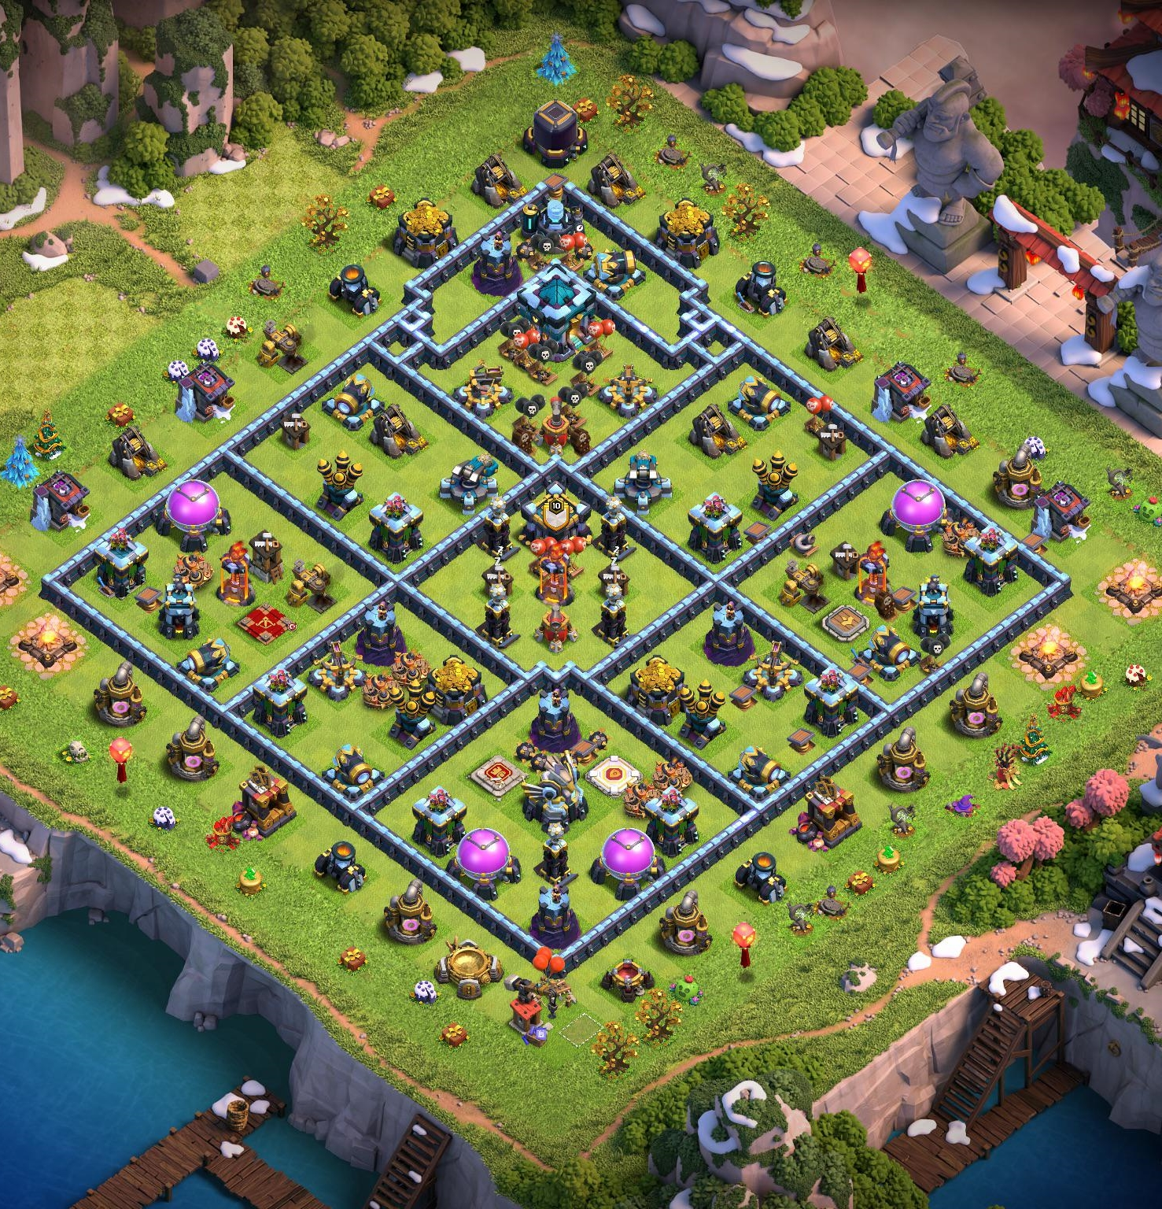
The effectiveness of compartmentalization strategies
Efficient multi-thread operation:
Maximize the performance of the multi-thread structure by reducing collisions
Improving performance by allowing each thread to stably process independent tasks
Advantages of a well-compartmented structure:
Reducing the risk of deadlocks, minimizing locking, and maximizing the efficiency of task distribution
In order to effectively utilize multi-threads, it is essential to appropriately separate tasks and actors through a compartmentalization strategy
A well-compartmented structure is the key to stable and efficient server operation

Slide 30
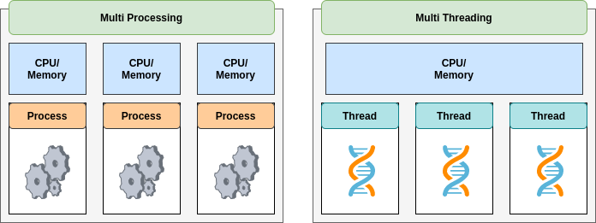
MMORPG Server Concurrency Structure: Multi-Thread vs. Multi-Process

Slide 31
Difference between multi-thread and multi-process
Multi-thread structure:
Multiple threads operate within a single process, and use shared memory.
Easy to share data between threads.
Data collision and lock management required (risk of deadlock and collision).
Multi-process structure:
Multiple independent processes run on a single computer, and each process has a separate virtual memory area.
Memory independence eliminates data collision and lock management issues.

Slide 32
Advantages and limitations of multi-process architecture
Advantages:
Independent memory area: No interference between processes, each process can run independently without worrying about memory invasion
No lock management required: Each process uses its own memory area, minimizing locking problems
Limitations:
Interaction limitations: Cannot interact with actors in other processes (ex: A cannot attack B)
Limitations in games: Since the core of the game is interaction between actors, inter-process interaction limitations affect the game playability.

Slide 33
The need and complexity of inter-process communication
Inter-process communication method:
Communication is possible through methods such as IPC (Inter-Process Communication)
However, communication efficiency and complexity increase → Multi-threaded structure is more advantageous
Inevitable constraints:
Importance of interaction: Since interaction between actors is essential due to the nature of the game, there are limitations to multi-process structure!
Multi-threaded structure is more suitable for games with a lot of interaction and data sharing
However… applicability for multi process models can be found in many MMORPG games…
In areas where there is no need to interact with each other, a multi-process structure may be suitable…
If each process operates independently and there are no locking problems or memory conflicts!

Slide 34

Independent continent-based multi-process application
Example of independent continent operation:
For example, in the early days of WoW, there were two continents, and no interaction between the continents was required.
Independent process allocation: one continent is handled by process A, the other by process B, and they operate independently.
No interaction between the continents is required, so communication and interaction are unnecessary.

Slide 35
Once again… benefits of a multi-process structure
Increased efficiency in the application area:
Assign separate processes to each continent to manage actors only within the area
Reduce lock management issues and maximize parallel processing performance
Independence between processes:
Ensure performance and stability as each process is independent in memory and work

Slide 36
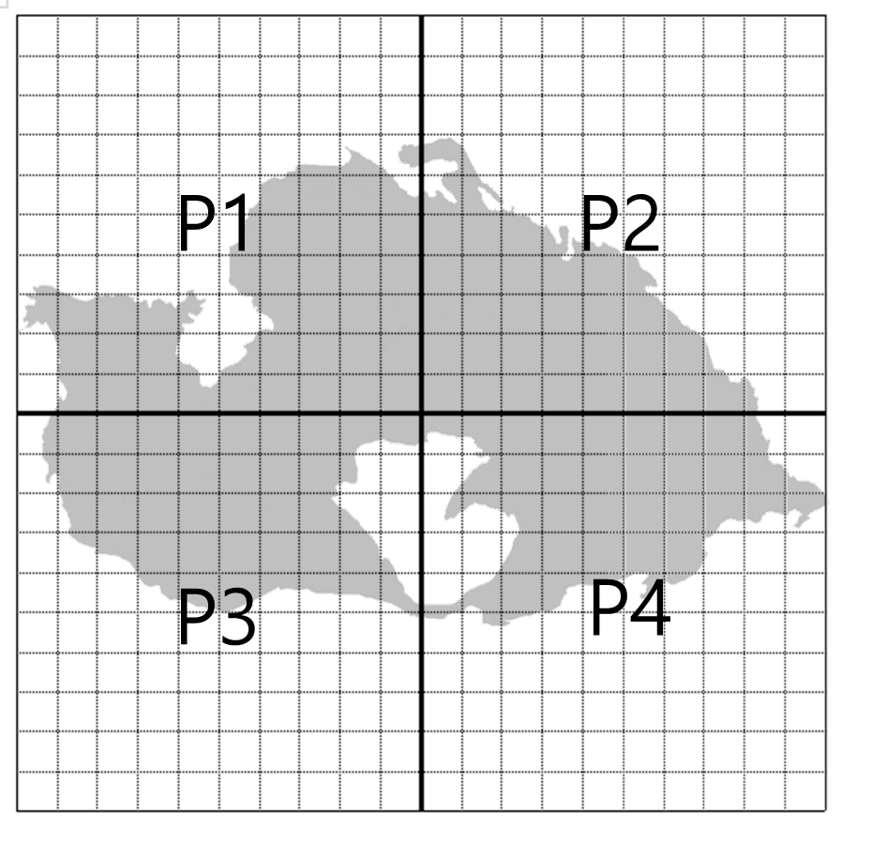
Restricting interactions in the boundary zone
Even within the same world, interactions between characters close to the boundary area may be required.
Interactions at the boundary (e.g. combat) require inter-process communication, increasing complexity.

Slide 37
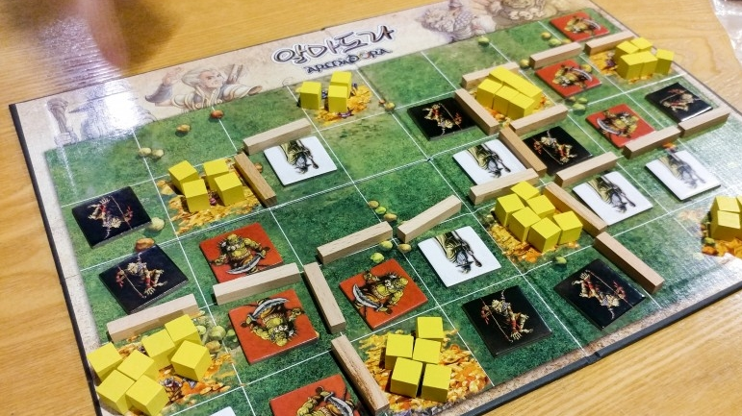
Boundary Interaction Problem Solving Strategies
Content restrictions:
Introducing a loading screen: Completely separate loading screen when moving to a zone
Adding a means of transportation: Blocking interaction by moving to a zone using a specific means (e.g. airplane, ship)
Setting a boundary zone: Preventing physical interaction by limiting combat and interaction in the boundary area
Advantages of compartmentalization:
Complete separation between zones possible through interaction restrictions → Secured performance and stability
Each zone operates independently, maintaining the performance of multi-process and the simplicity of single thread

Slide 38

Multi-process configuration: Horizontal partitioning vs. vertical partitioning
Horizontal Sharding Concept:
A method of dividing the world according to terrain on a two-dimensional plane
Example: Dividing the world into several areas and managing each area with a separate process
Separate management is required when moving between areas
Vertical Sharding Concept:
Separating servers and managing them according to function
Example: Separating by function such as combat, movement, NPC management
Performance optimization is possible by managing each function independently

Slide 39
Channel-based sharding
Need for channel method
Solving the problem of large-scale user concentration:
Example: When 5,000 users are concentrated in a metropolitan area, it is difficult to manage with a single process
Channel method: Users are divided into groups of 500 and each of 10 processes manages them
Advantage: User distribution reduces the load on each process and increases server stability
Disadvantage: Interaction is impossible when in a different channel. This is a major disadvantage in MMORPGs that consider social elements important
Mixed strategy: Horizontal sharding and channel sharding can be used in parallel
Example: After dividing the region horizontally, users can be further divided within each region using channel slicing
Relieve overload in specific regions through horizontal and channel sharding

Slide 40

But… how about Seamless world?!?
Seamless world:
A game environment where users can move and interact like water flowing without a loading screen
Required when all users want to interact in one world based on a single process!
Come back to the necessity of multi-threading:
It is essential to scale to a multi-threaded structure to handle a large number of users and actors
Hence, efficient work distribution is required through structuring and compartmentalization strategies with multi-thread!

Slide 41
The Core of Multi-Threaded Structure: Compartmentalization Strategy
Importance of compartmentalization:
Simple multi-threading can lead to crashes and deadlocks, so compartmentalization is essential
Careful compartmentalization is needed to enable efficient work distribution and interaction management
Next steps:
Optimizing multi-threaded performance with various compartmentalization methods and structural approaches

Slide 42
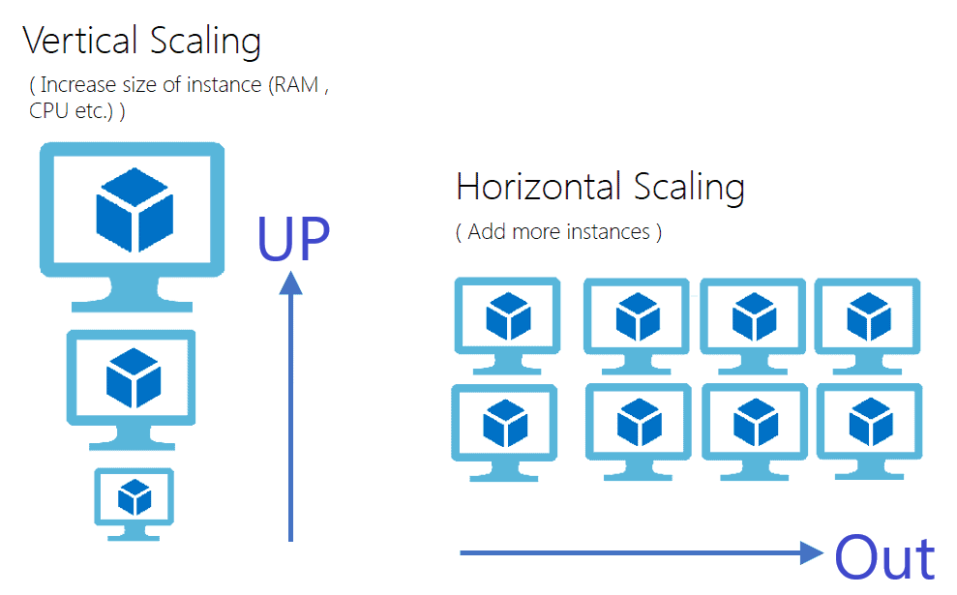
IV. Scale Up / Scale Out

Slide 43
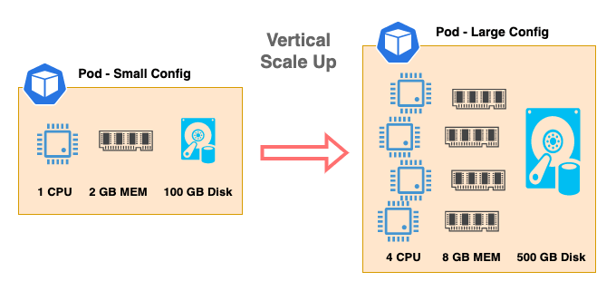
Scale up

Slide 44
Characteristics of scale-up method
Single process dependency:
Since server performance depends on a single process, as machine performance increases, the performance of the server process also improves.
As machine performance increases, the server's ability to handle concurrent users increases.
Major methods back in the days:
The scale-up method was widely used in early MMORPGs.
Scalability is maintained by gradually replacing server machines with high-performance ones.
Advantages:
The structure is simple, making it easy to manage and operate.
Since it is operated as a single server, data synchronization and management complexity are reduced.

Slide 45
Limitations of scale-up approach
Current problem:
Despite increased CPU performance, program performance no longer increases proportionally.
Limiting point reached: As machine performance increases, process performance increases at a non-proportional rate.
Scalability limitations:
There are costs and physical limitations in continuously upgrading the performance of a single physical machine. (Extremely expensive!)

Slide 46
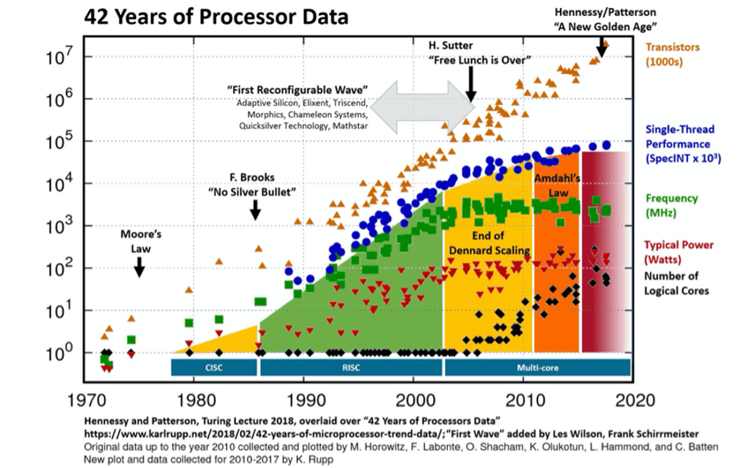
Free Lunch is Over!
Conceptual explanation:
A concept mentioned by programmer Herb Sutter, emphasizing the importance of concurrent programming
Single core clock speed limit reached → Performance expansion through multi-core
The free lunch due to continuous improvement of CPU clock speed is now over
Reason:
Modern CPUs adopt a multi-core method that increases the number of cores to improve performance
However, if software does not effectively utilize multi-core, performance improvement is limited
Now, a structure design that effectively divides multi-processes and threads to maximize performance is required.

Slide 47
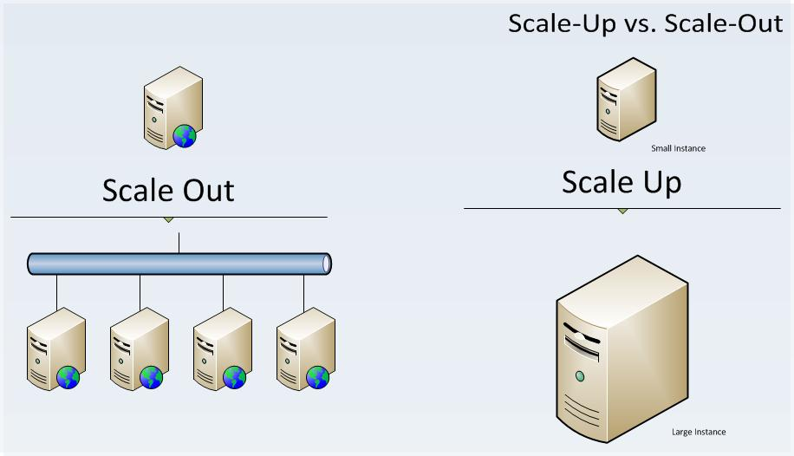
Scale out
A structure that can dramatically expand server performance
The scale-up method can be seen as a single-process structure, and the scale-out method is a multi-process structure
After the free lunch is over, performance is increased by scale out
Whenever performance is needed, increase the number of machines
Multiple processes conduct tasks in parallel

Slide 48
Importance of Scale-Out Nowadays
The End of Free Lunch and Scale-Out:
Due to the limitations of CPU performance improvement, it is difficult to secure performance through scale-up alone
Scale-out secures performance scalability by distributing performance through multiple machines and processes
Scale-out method
A multi-process approach that makes server performance flexible and scalable,
A core strategy of modern server architecture that simultaneously addresses performance limitations and cost efficiency
Better in Economic and Availability points of view

Slide 49
Economics of scale-out
1. Scale-out method: Scalable with low-cost equipment
No need for high-performance machines
Example: Machine equipped with 2GHz dual-core CPU + 8GB RAM
Cost: Estimated to be around $200~$300 in wholesale price
Cost comparison: 10 low-spec machines → around $2,000
2. Cost comparison with high-spec equipment
Example: Machine equipped with 32-core CPU 5GHz, 1TB RAM, …
High cost: at least tens of thousands of dollars
10 low-spec machines < 1 high-spec machine
Cost efficiency: Scale-out is advantageous

Slide 50
Combining the flexibility of virtual machines with the cost-effectiveness of scale-out
1. Utilization of virtualized resources
Virtual Machine: Not an actual machine, but a virtualized machine
No need to know the configuration of the actual machine
2. Example: Virtual machine in AWS (Amazon Web Services)
AWS manages the resources of virtual machines and dynamically distributes resources as needed
Actual machine configuration: Users do not know and do not need to know
Providing low-spec machines is not a big burden for Amazon
3. Cost-effectiveness of scale-out method
Mass utilization of low-spec machines: 10 or 100 low-spec machines are cheaper than 1 high-performance machine. In terms of cost, scale-out method is more economical

Slide 51
Availability
1. What is Availability?
Availability: refers to the degree to which the system is available
A concept related to the stability of the server, with the goal of providing uninterrupted service
2. Limitations of a single server
Example: The world server operates as a single process
If a single process is terminated, all players cannot access it
Service is down until the server is restarted
3. Need to secure availability
In a single server environment, there is a risk of complete service interruption in the event of a failure
Increasing availability is essential for the stability of the MMORPG server!

Slide 52
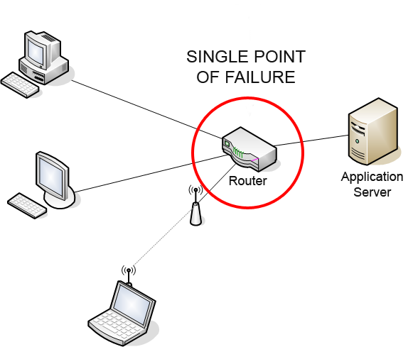
Single Point of Failure
What is a Single Point of Failure?
Definition: A situation where a single point of failure causes the entire system to be unavailable
Example: If a server, running based on a single process, fails, the entire game service becomes inaccessible
Problem: There is a high risk that the system will be completely unavailable due to a single point of failure if we only run a single server!

Slide 53
V. Transition to multi-process structure
Multi-process: Configure the same server as multiple processes
If one process fails, other processes continue to provide service
Mitigate single point of failure, increase availability

Slide 54
The practicality of multi-processing
Single Process vs. Multi-Process
Single Process Structure:
Low availability, risk of complete service outage in case of failure
Relatively high cost
Scale up: Expand high-performance equipment → Increase cost, availability issues
Multi-Process Structure:
High availability, service can continue even if one process fails
Improved cost efficiency, stable service provision possible
Scale out: Expand multiple low-performance equipment → Reduce cost and provide high availability
Natural flow of change

Slide 55
Single Process Tradeoffs
Pros: Provides a simple and seamless user experience
Limitations: Lack of high availability and risk of entire server down in case of service outage
Single-process architecture has the advantage of providing a simple and seamless user experience, but has limitations in terms of high availability and scalability.

Slide 56
The single-process advantage is back
Simplicity of structure
Single process: One process handles all tasks
Simple structure makes it easy to manage
No need for complex inter-process communication
Seamless World
Seamless: A single process handles all worlds → Provides a seamless environment
Users can move freely within the world
Advantage: User experience is seamless
Possibility of disconnection in multi-process:
If there are multiple processes, intermittent disconnection may occur when moving
Management and management between processes are required
Version control: Requires simultaneous deployment to multiple servers when updating

Slide 57
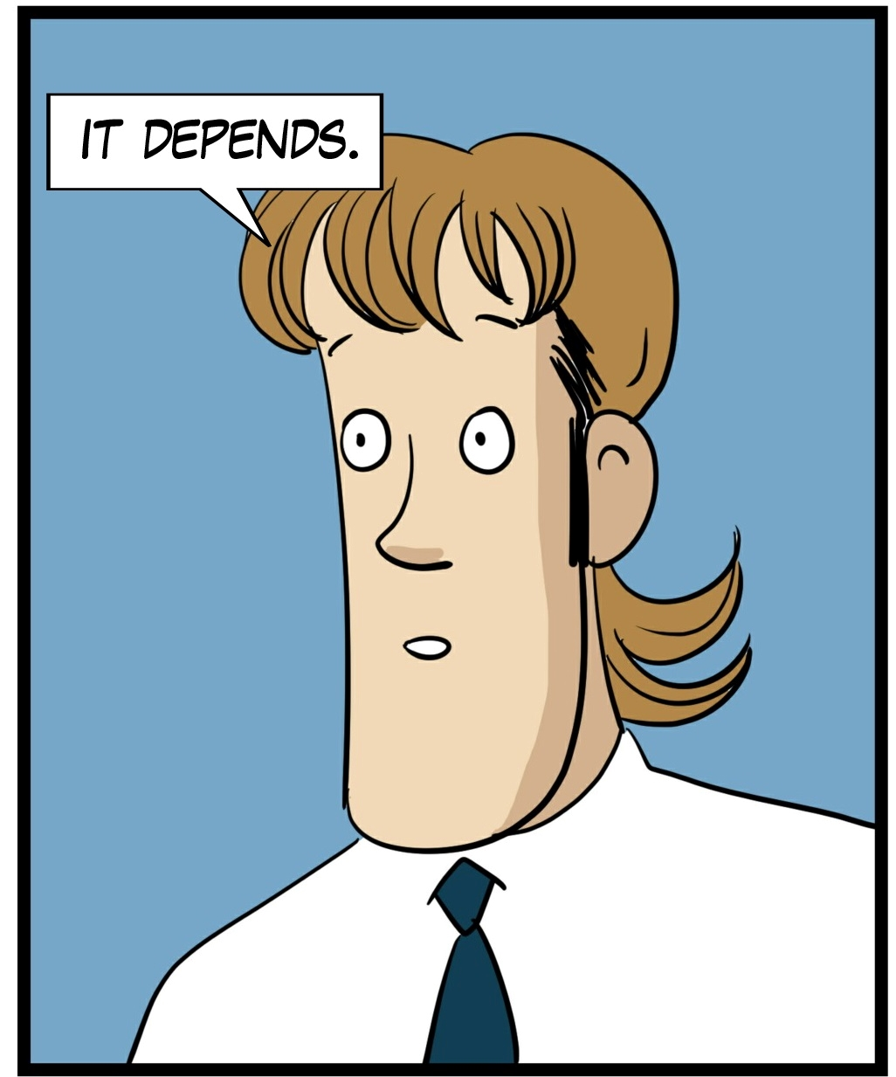
But… then again… if we like to support a large number of concurrent users, costs, availabilities…
What should we do?!?

Slide 58
The shift to scale-out and the need for management automation
Increase in multi-process due to scale-out conversion
Increase in number of servers → Need to manage hundreds of processes
Automation is essential: Manual management is impossible
Single process provides a seamless environment, but multi-process structure is essential anyway for high availability, and management complexity must be resolved through automation from now on.

Slide 59
Evolution of scale-out and automation tools
Emergence of various automation tools
Jenkins: Build automation tool
Ansible, Chef: Server configuration management and automatic deployment tools
Kubernetes, Docker: Container management and deployment tools
AWS: Cloud environment management → Need to understand the AWS ecosystem
Various open source projects: Continuously emerging to meet automation and scale-out needs
Increased complexity and need for learning
Complex environment: Increased diversity of tools and environmental complexity
Increased burden on program operators: Need for knowledge of using and managing multiple tools
It takes a lot of time to understand all automation tools and cloud environments

Slide 60
The Need for DevOps, managing game server
DevOps: A term combining software development and operations, it is a development and operations approach that aims to increase the speed and quality of software development through collaboration and automation between software development and IT operations teams.
Need for DevOps: Need for experts specializing in automation tools and scale-out management
New job group: DevOps experts who manage development and operations in an integrated manner
DevOps is responsible for efficient system operation, automation construction, and scale-out support
With the development of scale-out and automation tools, specialized jobs such as DevOps have become essential, and knowledge of automation tools has become the core of modern IT infrastructure operation, including game servers.

Slide 61
The Importance of Management in Multi-Process Servers
Monitoring and Recovery
Essential elements for stable operation in complex environments
Monitoring: Real-time server status check to enable immediate response when a problem occurs
Recovery procedure: Automated recovery and connection of alternative processes in problem situations
The role of DevOps
Specializing in the deployment, management, monitoring, and recovery of multi-process servers
Contributes to efficient server operation and service continuity
∴ Systematic management and the role of DevOps are essential for stable operation of multi-process servers

Slide 62

Multi-threaded server architecture
Single vs. Multi-threaded Choice
Need for multi-threading in single process:
Since the clock speed of modern servers is not high enough, utilizing multi-threading is essential even in single process
Combination of multi-process and multi-threading:
Even in a multi-process environment, each process can be configured as multi-threaded
System performance and stability vary depending on how processes and threads are configured.

Slide 63

EoF

